Slide 1
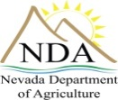
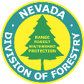
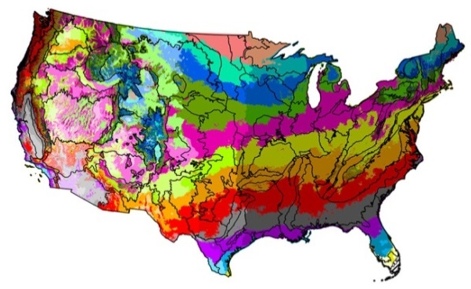
Nevada Native Seed Forum
Definitions
Native plant: indigenous terrestrial and aquatic plant species that have evolved and occur naturally in a particular region, ecosystem, or habitat. | Seed Transfer Guidance: recommendations for protecting adaptations of wild populations by restricting seed transfer only to areas where they will grow, reproduce successfully, and produce no adverse genetic effects. | Wildland collected seed: seed that is harvested from a native plant community on uncultivated land (G0 seed).
 |  | Source Identified seed: inspected seed that is harvested from uncultivated land, seed production areas, seed fields, or orchards where no selection or testing of the parent population has been conducted (G0 seed).
Non-native plant: alien, foreign, nonindigenous, or exotic plant species that have been introduced by humans to a location(s) outside its native or natural range.
Invasive plant: a plant that is both non-native and able to establish on many sites, grow quickly, and spread to the point of disrupting plant communities or ecosystems. | Seed Zone: a mapped area with fixed boundaries in which seeds or plant materials can be transferred for the best chance of success. | Foundation seed: the earliest certified generation of seed available to producers for seed production (G1 seed).
 |  | Bulk seed: refers to seed that does not take into account its purity and germination.
Locally adapted plant: a plant from an area geographically near a planting site that is environmentally adapted and likely to establish and persist.
 |  | Pure-live-seed (PLS): the amount of live, viable seed in a lot of bulk seed.
Workhorse species: locally adapted native plants that are abundant across a wide range of ecological settings, establish quickly, and produce high ground cover on disturbed sites.
Provisional Seed Zones from Bower et al. 2014
PURITY x PERCENT TOTAL GERMINATION
= % PLS
100

Slide 2
Notes:
The VISION of the strategy is
The right seed in the right place at the right time.
The MISSION is
To ensure the availability of genetically appropriate seed for healthy and productive plant communities and sustainable ecosystems.
This is relevant on both public and private lands across the U.S.

Slide 3
A Coordinated, Strategic Approach
Announced Aug 2015
Developed by the Plant Conservation Alliance (PCA)
Brings together 12 Federal Agencies and more than 300 other organizations
Provides a common set of goals and actions to help us move forward together
Notes:
Many people ask why we need a strategy when work is ongoing.
While this is true, we all need to be on the same page – working together.
The strategy provides a common set of goals and actions to help us move forward together.
And there is an urgent need to step up this work because of an increasing need for seed.
No one or two agencies can do it all.
*Only country in the world with a National Seed Strategy

Slide 4
Moving Forward: Success Looks Like…
Networks of :
Seed Collectors
Researchers
Farmers
Nurseries and seed storage facilities
Restoration ecologists and botanists
Networks of:
Public Land Managers
Policy Makers
Tribal Land Managers
Private Land Owners
Communication and Education
Bridging the Gap
Between

Slide 5
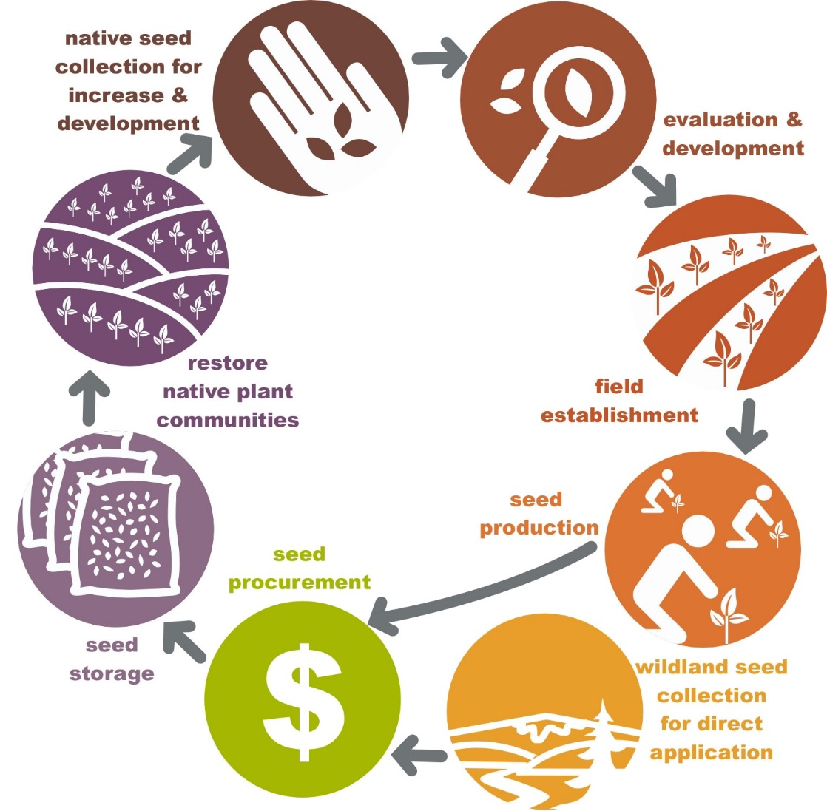
Great Basin Partnerships within the Cycle of Seed Collection, Development, Production, and Use
Collecting Seed:
BLM/FWS/FS
Great Basin Native Plant Project
Mining Industry
Non-Profit Groups
State Agencies
Develop Seed Transfer Guidance:
Great Basin Native Plant Project
Figuring Out How to Germinate, Establish and Manage Fields:
Great Basin Native Plant Project
Universities
NRCS Plant Materials Centers
Using Seed:
BLM/FWS/FS
Mining Companies
Ranchers
State Agencies
Wildlife
Forestry
Highways
Outreach to Growers:
NRCS Plant Materials Centers
Resource Conservation Districts
State Dept. Ag
Understanding How to Use Seed:
Great Basin Native Plant Project
Universities
USGS
Helping Growers Establish Fields:
RCDs
NRCS Plant Materials Centers
Storing Seed:
BLM/FS Seed Warehouses
Private Growers
State Seed Warehouses
Producing Seed:
Non-Profit Groups
Private Growers
State Nurseries
Procuring Seed:
BLM Seed Warehouse
Seed Industry
Seed Certification Programs
State Agencies
Seed Cleaning and Testing Facilities
Crop Improvement Associations
Collecting Wildland Seed:
Federal Agencies
Non-Profit Groups
Seed Industry
State Forestry Programs
Seed Cleaning and Testing Facilities

